Slide 1

DriverPass System Analysis
Fellipe Demoraes
Notes:
[No speaker notes required for this slide.]

Slide 2

System Requirements
The system shall have assessments and track student progress in the course
The system shall have structured lessons for the student
The system shall implement a third-party payment API when choosing a package
The system needs to be hosted by a cloud provider
The system will need a domain name registered
The system needs a beginner friendly user interface
Notes:
The system we are building is a learning management system. The first and second functional requirement listed on the slide explains that learners need structure and organized lessons. They also need to see how they are progressing in the course. This helps students know how well they are doing before taking the real exam. As a student progresses through the course, the system updates and saves as the student passes checkpoints and sections of the course. The course including reading materials and any assignment is provided from the business end.
The third functional requirement is a third-party payment API or system. This allows students to pay for the desired package. It is third party because it comes from a different software company that specializes in payments. API stands for application programming interface. It is the API that allows the DriverPass developers implement the payment system in the system. Payment API’s include Stripe, Square, and PayPal. This allows the student to conveniently start the course no matter what time or day, so while the company can grow, the payment API will take care of the payments for the company. The API payment will charge a fee as part of the service.
The fourth listed says that the system needs to be hosted by a cloud provider. A cloud provider is a company that have servers that you can own and use for the system. There are several benefits like scalability and security. Scalability allows your business to grow without any hardware and processing limitations. Also, it’s unlikely the server will brake and lose all your data because there are many servers connected to one another. If one breaks, another server will have your data instead. This will help DriverPass have the reputation as reliable to the local markets and beyond.
The system will need a domain name. Domain names need to be registered with the cloud provider. This allows anyone across the internet to use the name driverpass.com to access your website, or else it would have to be a internet address like 654.65.23.144.
Finally, the system needs a user-friendly user interface. The user interface is the layout of the website and how it looks. It’s important for it to be intuitive and simple to use, so then the learners can spend most of the time learning the course material and taking the assessments.

Slide 3
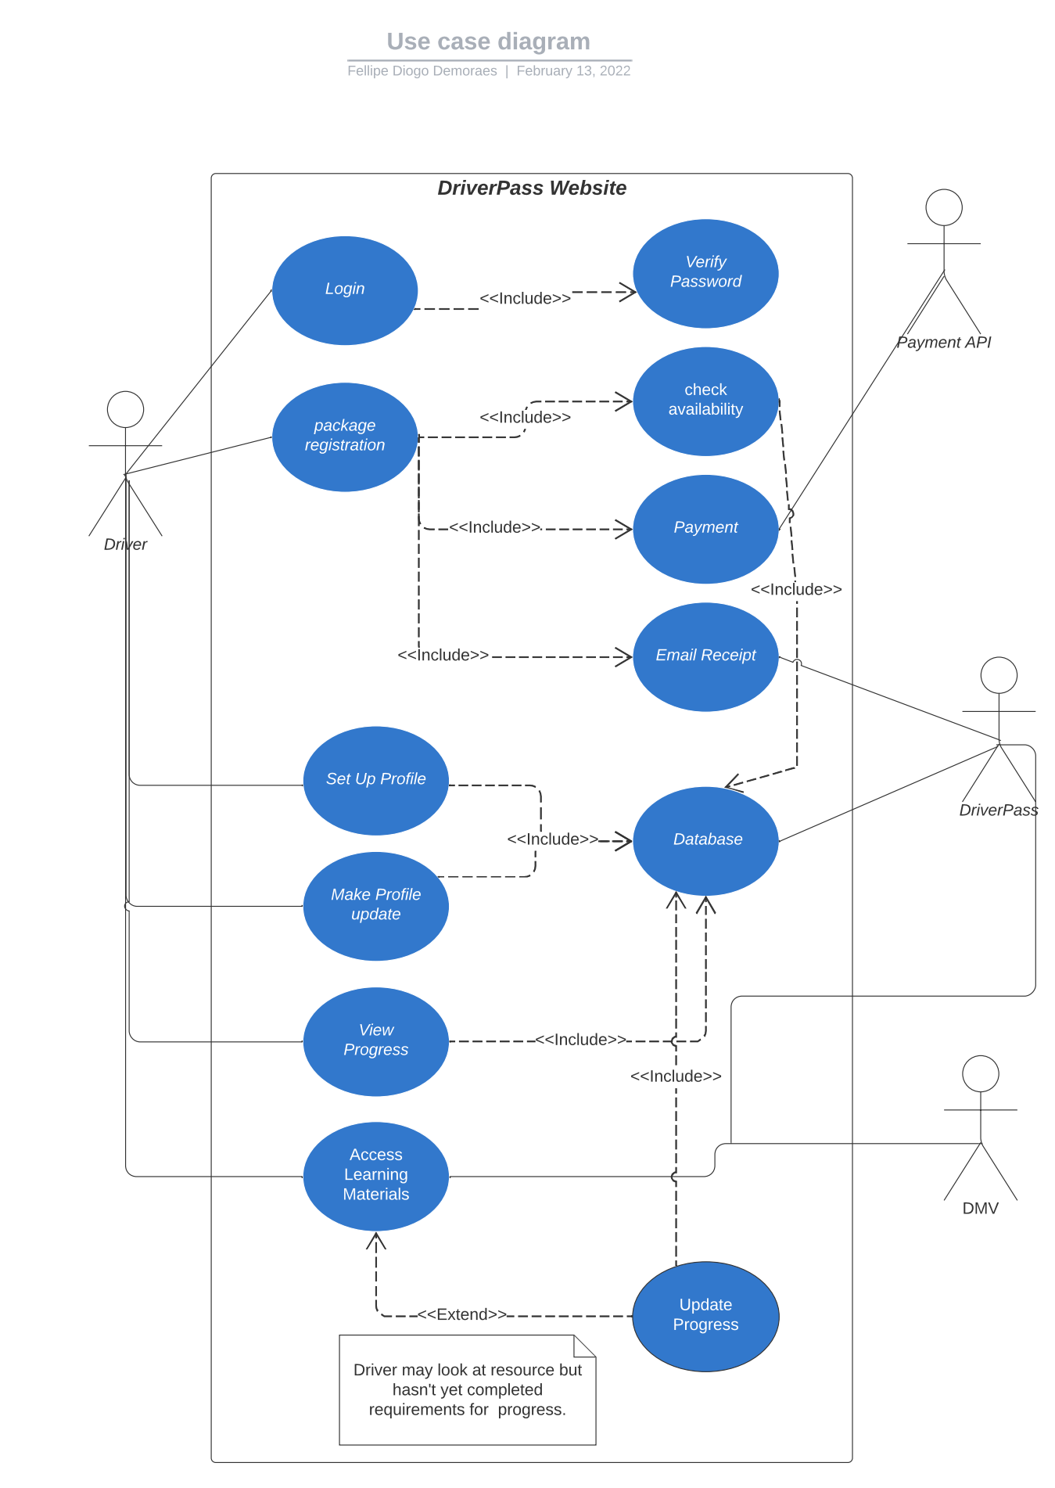
Use Case Diagram
Notes:
The use case diagram for the DriverPass system is on the right. It has 3 actors: the driver/learner, payment API, DriverPass, and the DMV. The first shown is the login that has a include arrow line to verify password. This line relationship means that the following circles occurs when the initial circle runs, so a verify password happens each time the driver logs into the system. This will help the DriverPass system be secure from hackers. Next, Driver is on package registration. Package registration has 3 include relationships: check availability, payment, and email receipt. The included actions occur in the order exactly. Notice that check availability has a include relationship with the system database at the bottom. Check availability will know from the database if a package is available. Next is payment, which has an association with the payment API actor, so the payment API is responsible for the transaction to occur. Lastly, the email receipt will happen. DriverPass will have logic in the system that will send emails automatically from the company to the buyer, so the company won’t have to do it manually. After package registration, there are Set Up Profile and Make Profile Update. The Driver will be able to save information like current email and physical address to the system because the data will get saved to the database after the Driver is done. DriverPass will have up to date information on it’s clients as result.
View Progress and Access Learning Materials are the main features of the system. Access Learning Materials is going to be managed by DriverPass. DriverPass will need to stay up to date with the DMV regulations in order to keep the learning content relevant to the student. This helps the Driver to be learning up to date information, and then pass the exam. Update Progress keeps track of how the Driver progresses in the Access Learning Materials. Sometimes, Driver won’t make progress, so no progress will be made until there is. The data is saved to the database. View Progress will get the Driver progress from the database and show that to the Driver. This can help as a motivator for the Driver to do better in the course.

Slide 4
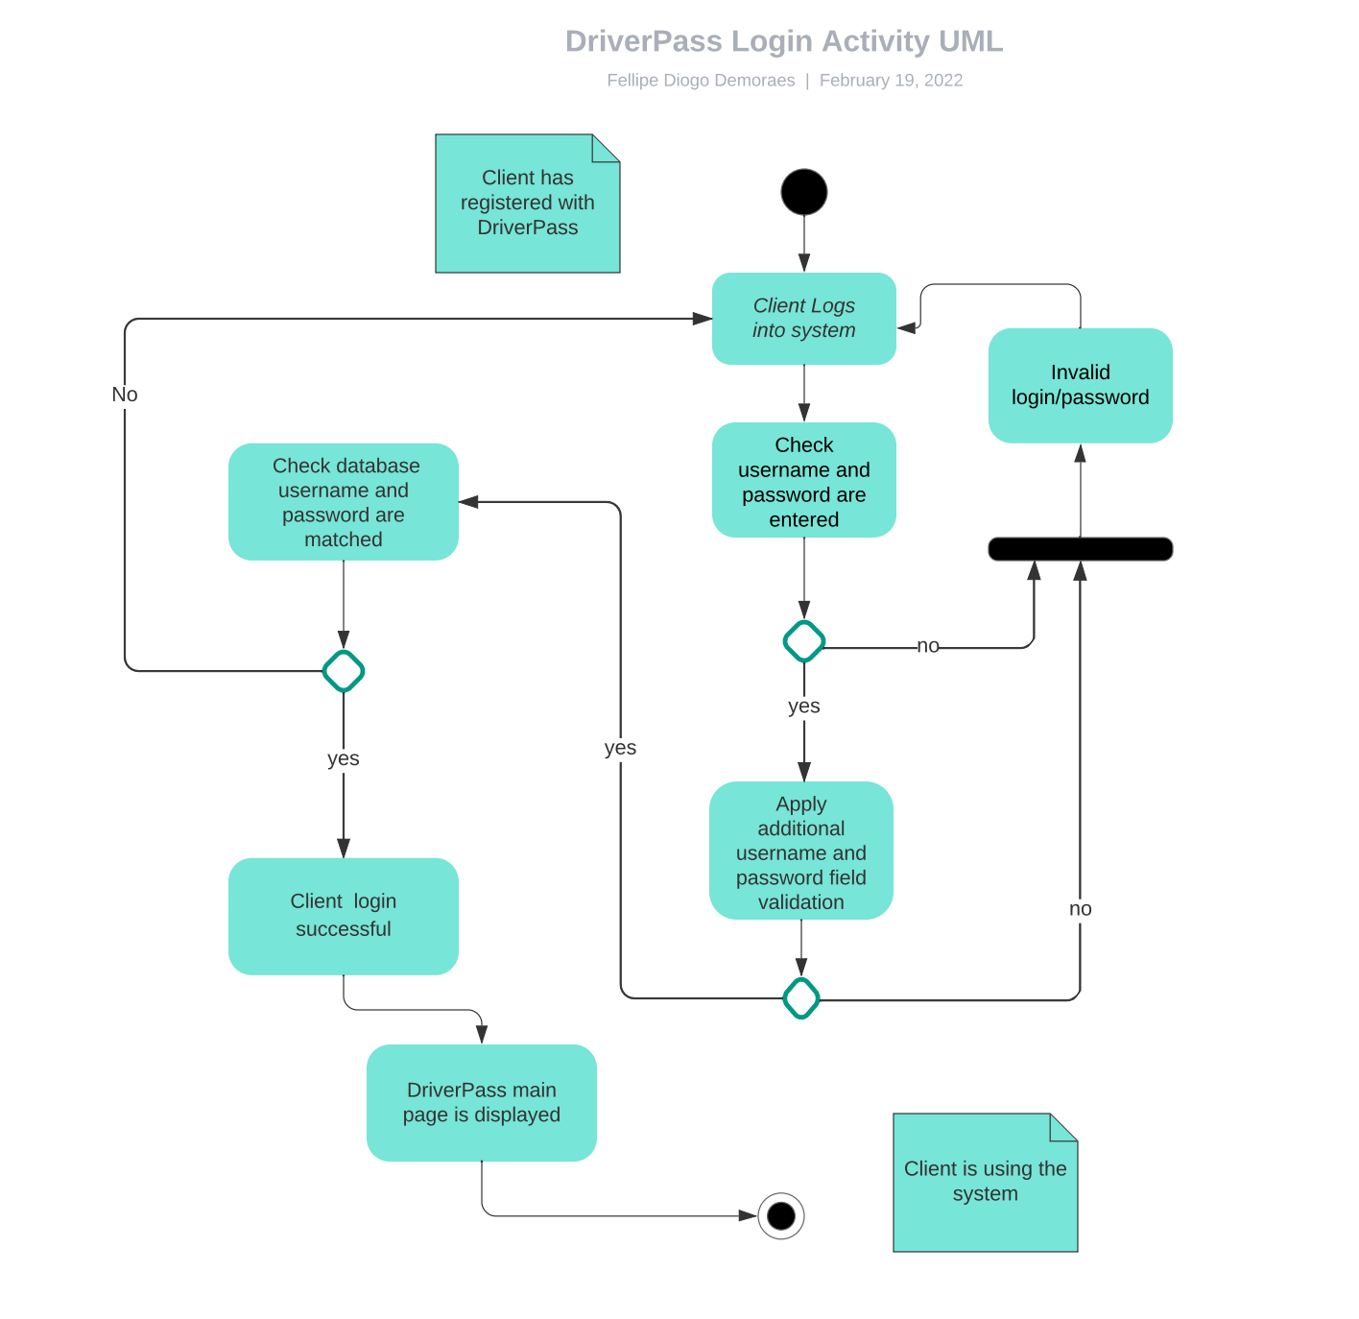
Activity Diagram
Notes:
The DriverPass Login Activity UML describes the first case from the Use Case Diagram Login. The diagram starts with the client trying to log into the system. Next, the system checks that the username and password is entered before continuing. If ether isn’t entered, the system returns to the client logging in step. This helps the system by not having to send data to the server because the server will deny the password anyways, and it will save computer resources .If it were entered, then the system applies additional validation rules to the username and password data. Validations will check if password and username meet the complexity requirement to be accepted. For instance, checking that the password has at least 10 characters, and use of characters and numbers in a password is required. If it doesn’t meet the specification, the system returns to the client logging in step. This helps the system by making it harder for user accounts to be unsecure. If the validation checks pass, the system checks the database username and password with the provided username and password. If passwords don’t match or the username doesn’t exist, then the system moves back again to the client logging in. If it is a match, the system allows the client to have access to the system and the main page is now displayed.

Slide 5
Security
In the UML class design, there is a login security implementation that checks for SQL injections, brute force attacks, and password complexity
The system is hosted by a cloud provider, so there is less of a chance of hackers getting access to the server itself
The cloud provider will also ensure reliability by maintaining the servers and keeping them on 24/7
Notes:
Security is important, so the design programming interfaces that allows the developers to check for SQL injections and brute force attacks. SQL injections are statements that confuse a program to think that password matches the password from the database. The programming interface will check if the password relates to SQL statements to prevent SQL injections from happening. Brute force attacks is when hackers use different passwords until the passwords match. The design addresses brute force attacks in 2 ways. First is by requiring passwords to be complex, so that it would take a hacker a lot of processing power to crack the password. Additionally, the design allows developers to find out how many times a user enters a password, so the business can decide that it’s 3 times and the account can get frozen for a period.
The design also specifies using a cloud provider. This minimizes the chance of servers getting stolen or hacked because cloud providers invest money in security personnel and equipment. A bonus to a cloud provider is the reliability that the system will be always running and there’s no cost associated with the server maintenance.

Slide 6
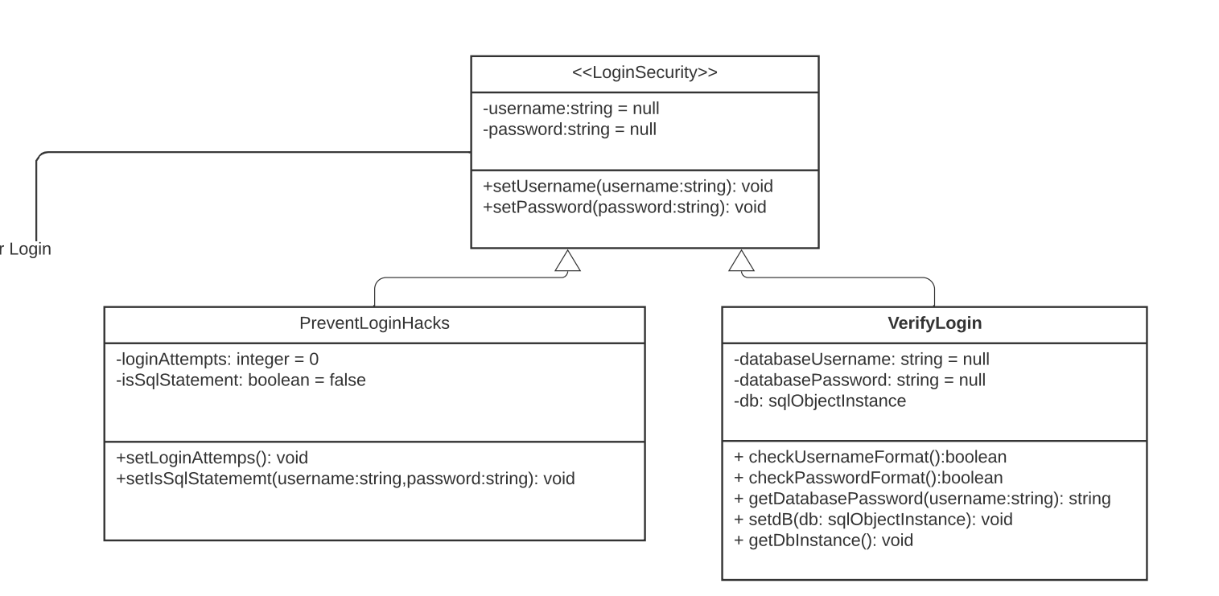
Security
Notes:
This part of the design shows the security aspect of the system. The system checks for the number of login attempts and if it’s an SQL statement. If ether of the checks fail, then the system gets routed back to the client login step, as previously shown in the login activity diagram. The system is also checking for the correct format such as password complexity and checking the database if the passwords are a match.

Slide 7
System Limitations
The Access Learning Materials needs to manually stay up to date with the DMV rules and regulations
The system doesn’t currently offer custom packages
Student drivers needs to register in person with DriverPass before having access to the system
Admins need internet connection and computer to connect to the system
Notes:
The first system limitation is that the system can’t automatically update the course content with relevant information from the DMV because there isn’t currently any third-party vendors that provide this as a solution. Therefore, DriverPass needs to update the course content when the DMV releases updated/new information.
The system doesn’t allow for students to choose custom packages due to the time constraint of the project. This feature for DriverPass can be in the system in the next system design project.
Students currently must register with DriverPass over the phone or in person and it’s not in the system design to allow students to register online. The students are allowed to select and buy packages online thugh. If desired, this feature can also be implemented in the next system design project.
Since the system will be located on a remote server owned by a cloud provider, admin will need internet connection and a computer to get access to the system, including the database. If the system was hosted locally, then the admin wouldn’t need internet connection to have access to DriverPass system and it’s data.

